Slide 1
Variables in Matlab

Slide 2
Variables
What is a variable?
Where do variables reside?
Global variables
Variable types
Naming variables
Accessing variables in Matlab
Indexing in Matlab

Slide 3
What is a variable?
A variable is a placeholder in Matlab’s memory
Variables have names
Variables can be used as the basis of operations
Variables can be assigned in the workspace or in an m-file

Slide 4
What is a variable?
Variables can be a single dimension or a matrix:
>> a = 3.5
a =
3.5000
>> amatrix = [1 2;3 4]
amatrix =
1 2
3 4
Note that spaces (or commas) denote the next column and semicolons denote the next row

Slide 5
What is a variable?
For a vector we just use a 3 by 1 matrix (column vector):
>> a=[1;2;3]
a =
1
2
3
Don’t use a 1 by 3 matrix (row vector):
>> a = [1 2 3]
a =
1 2 3

Slide 6
Where do variables reside?
When assigned in a non-function m-file or in the workspace, variables reside in Matlab’s workspace
In function m-files (we’ll discuss in later lesson) the variables exist only as long as the function is running
Global variables can be available in both functions and the normal Matlab workspace

Slide 7
Global variables
By inserting the word global before a variable name, that variable (once assigned) is available for any m-file (including functions) in which a similar statement is entered
  e.g.
  global MU

Slide 8
Variable types
When assigning number values, Matlab assumes they are real numbers with double precision
To assign a string value, precede and end the value with a single quote:
  Filename=‘myfile.m’
  Bikecolor=‘red’

Slide 9
Variable types
We can also define complex numbers
>> z=3+4i
z =
3.0000 + 4.0000i
>> y=complex(3,4)
y =
3.0000 + 4.0000i

Slide 10
Naming variables
Use variable names that coincide with the term you are using
  Semimaj might be a good variable name for the semimajor axis and will allow you to recognize where it is used
Variable names are case sensitive:
  semimaj, Semimaj, sEmimaj are all different variables
Avoid using function names as variables

Slide 11
Accessing variables in Matlab
To assign a variable use the “=“ sign
  a = 5;
To see the variable as you assign it, omit the semi-colon
  a = 5
Matlab replies with
  a =
  5
This is useful as you try to debug your programs

Slide 12
Accessing variables in Matlab
Finding what variables already exist in the Matlab workspace
  who function
  Workspace window
>> who
Your variables are:
a amatrix
>>

Slide 13
Accessing variables in Matlab
Clearing the workspace:
  clear
Clearing only specific variables
  clear A
Seeing variables out to more than 4 decimal places:
  format long

Slide 14
Indexing in Matlab
In many cases you may have a lot of information stored in a single matrix variable.
You may not want to use or perform operations on all of that data at once.
Refer to individual values or groups of values within the multidimensional variables by referring to the row and column numbers for the desired data.

Slide 15
Indexing in Matlab
Example:
To refer to the 14:
  A(3,4)
To refer to all of column 1:
  A(:,1)
To refer to all columns in row 2:
  A(2,:)
A =
1 2 3 4 5
6 7 8 9 10
11 12 13 14 15
16 17 18 19 20
21 22 23 24 25

Slide 16
Indexing in Matlab
Example:
Find the numbers in row 2 that are greater than 7:
  oddnum=find(A(2,:)>7)
  oddnum is the indexes in row 2 for the numbers greater than 7
  oddnum=[3,4,5]
A =
1 2 3 4 5
6 7 8 9 10
11 12 13 14 15
16 17 18 19 20
21 22 23 24 25

Slide 17
Indexing in Matlab
Example:
Find the dimensions of A:
  dim_of_A=size(A)
  dim_of_A=[5,5]
Find the size of the largest dimension of A:
  length_of_A=length(A)
A =
1 2 3 4 5
6 7 8 9 10
11 12 13 14 15
16 17 18 19 20
21 22 23 24 25

Slide 18
Indexing in Matlab
You can fill in arrays using shortcut commands
  1:5 is a list of numbers from 1 to 5
  1:2:9 is a list of numbers from 1 to 9 incrementing by 2
Example:
>> A=[1:5]
A =
1 2 3 4 5
>> A=[1:2:9]
A =
1 3 5 7 9

Slide 19
Exercises
Try the following examples and others on your own. There is no “turn-in” assignment for this however.

Slide 20
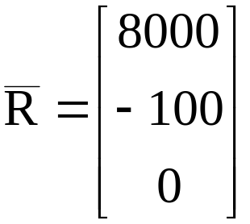
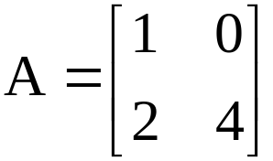
Exercises
What is the line of code that assigns this value to a variable, RVEC?
Assign this value to a variable, Amatrix.

Slide 21
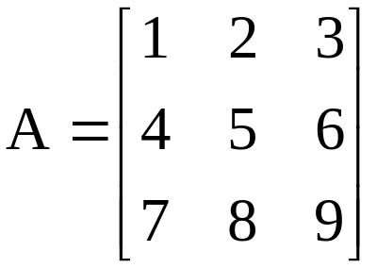
Exercises
Write the 1 line of Matlab code that places this matrix into the variable, A.

Slide 22
Variables
What is a variable?
Where do variables reside?
Global variables
Variable types
Naming variables
Accessing variables in Matlab
Indexing in Matlab

